Slide 1
ML2 2.5
Visual Applications of Machine Learning
Handwriting Recognition
Radar Recognition
By: Jordan Novelli

Slide 2
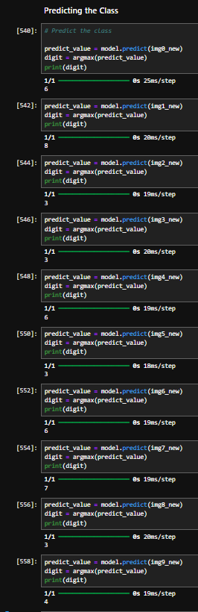
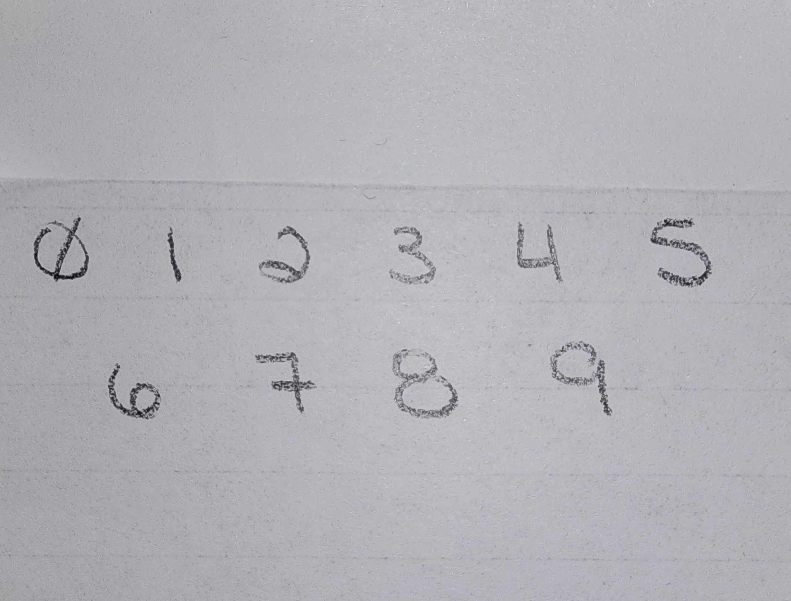
Handwriting Recognition
I went to the practice of the task and I wrote out my hand
Based on the predictions of my handwritten numbers the algorithm only got 3 correct (3, 6, 7).
I can understand mistakes the algorithm made for numbers: 0, 8 , 9 .
However, the incorrect suggestions were:
0 was 6,
8 was 3
9 was 4.
There was only 30% accuracy.
No letters were used.

Slide 3
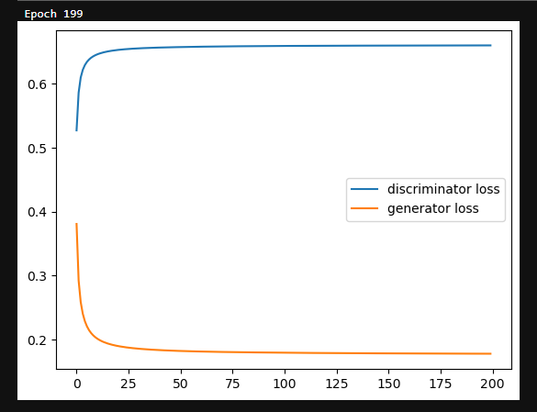
Radar Recognition
After running 200 epochs to determine if the radar recognition was reliable, I can see that the discriminator loss and the generator loss never conjoined
However, watching it from epoch 0 to epoch 200 it started from a graph with no lines to gradually increased loss.
The Discriminatory Loss started at 0.54.
Generator Loss started at 0.39.
There may be a misunderstanding within the data because both losses started at different ends.
I attempted a run of 500 epoch and after 6hours it only completed 357 runs. I had to interrupt that kernel.

Slide 4
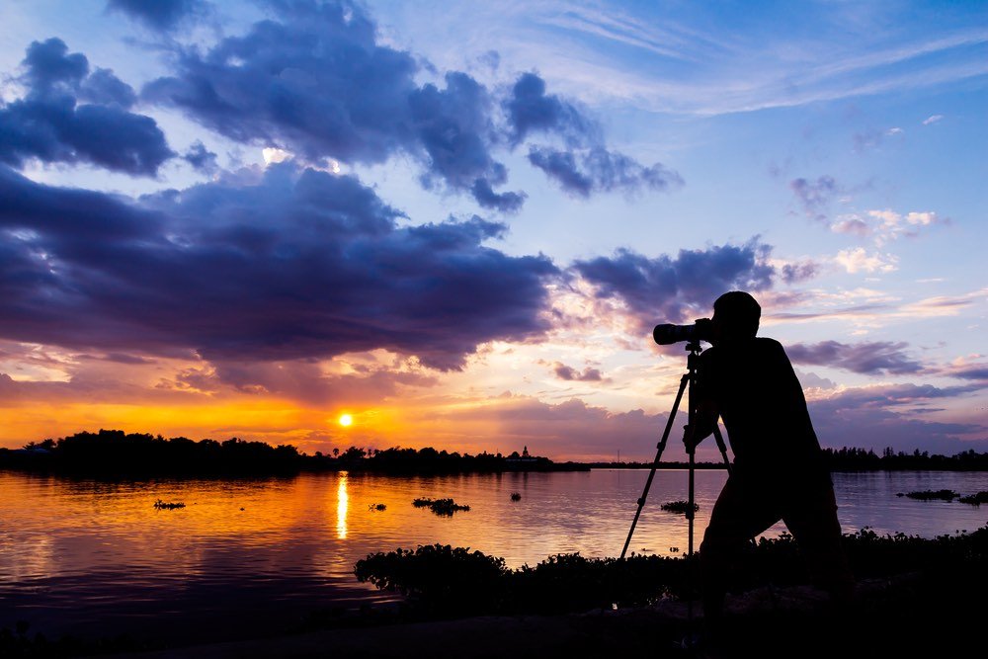
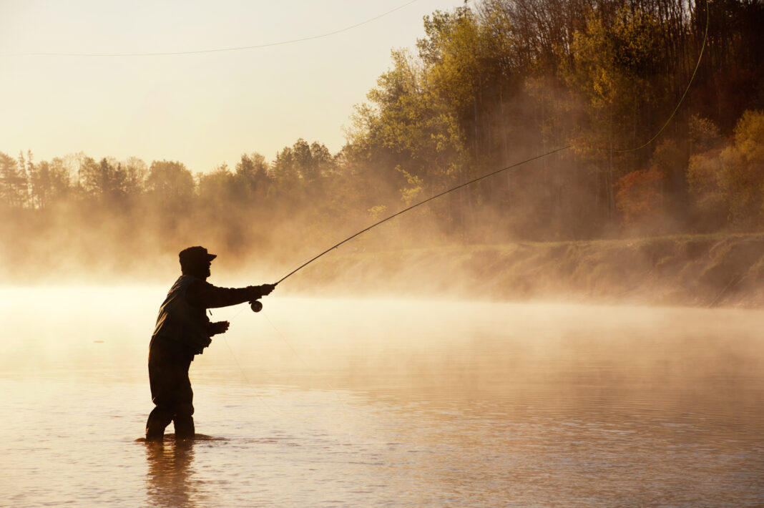
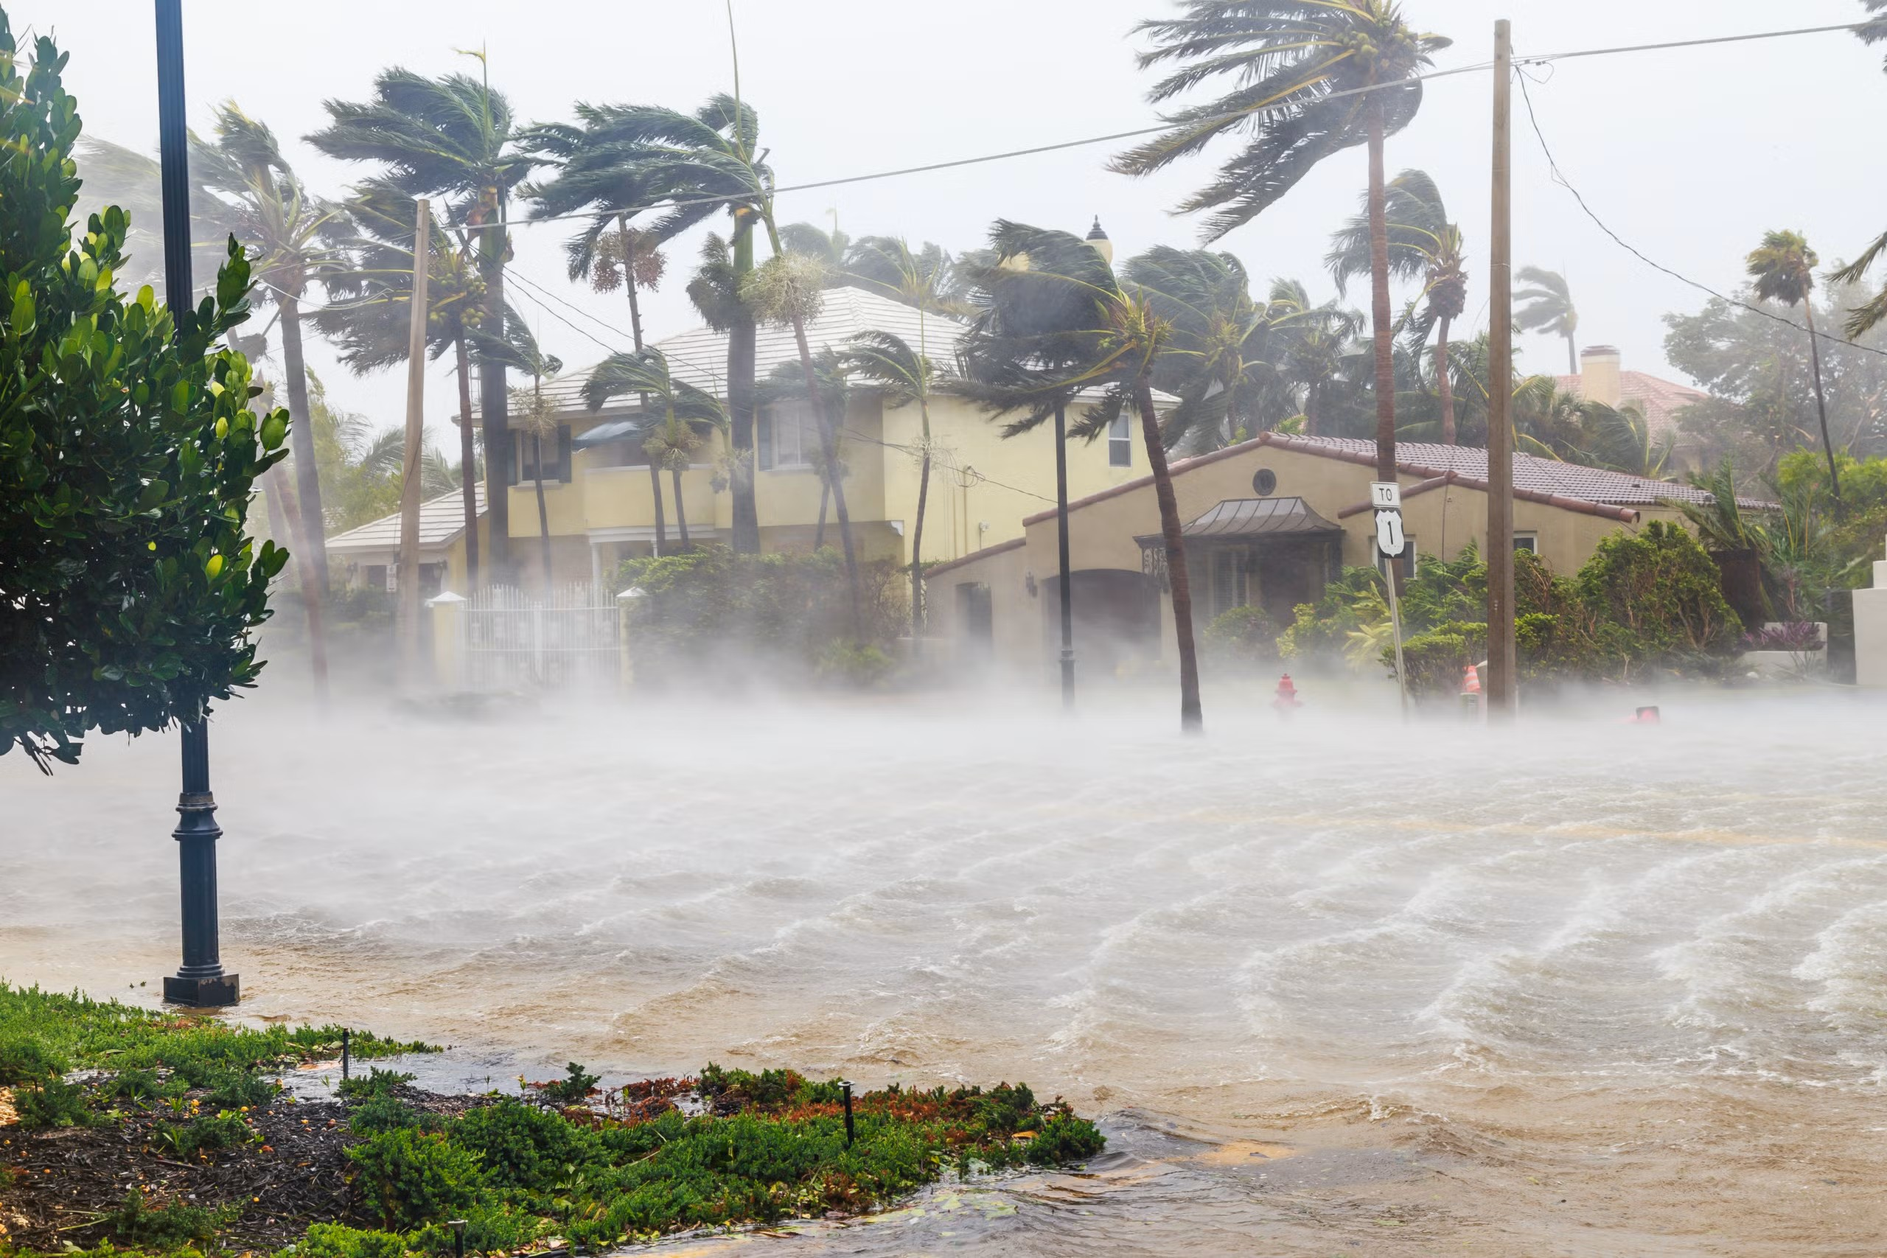
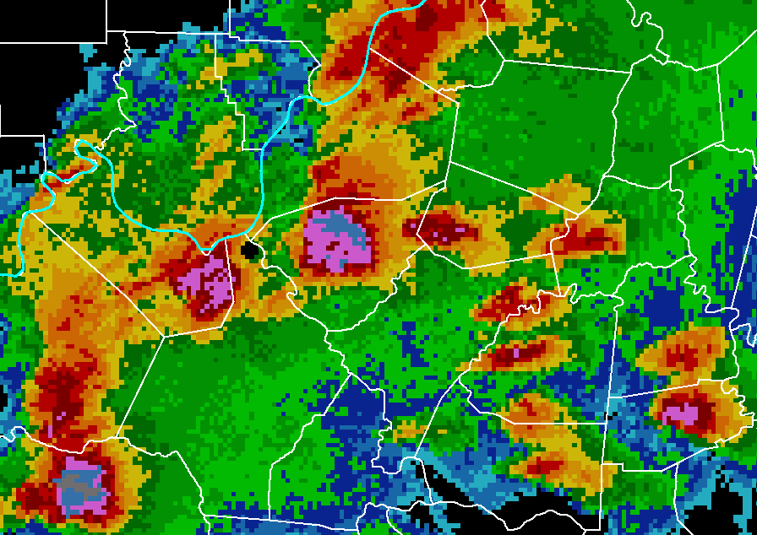
Radar Recognition
I believe the GAN can be very useful! For the simple lack of time I couldn’t dive deeper into correcting or shaping these GAN to created the optimal outcome.
Other uses for GAN in weather prediction can be
Natural disasters predictions
Best weather for specific outdoor activities such as hiking, kayaking, swimming or fishing.
Fishery read
Krill read
Best days for outdoor photography.

Slide 5
END

